Slide 1
IoT Final Project Dynamic Parking Space System
資工碩一 顏逸東
資工碩一 謝崴宇
電機碩二 吳明憲
電機碩一 林益璟

Slide 2


Scenario
Notes:
Senario

Slide 3
Scenario
How about changing the
parking space dynamically ?
Notes:
Senario

Slide 4



Technique

Slide 5
Parking law
scooter
car
2m
2.5m
1m
5.5m

Slide 6
Parking law - solution
scooter
car
2.5m
2.5m
1.5m
6m

Slide 7
Parking law - solution

Slide 8
Technique (cont.)

Slide 9
Technique
How about sensing parking space automatically ?
Magnetic Sensors

Slide 10
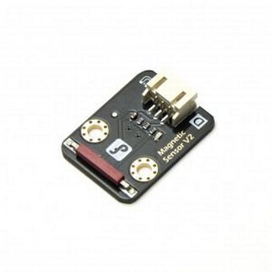
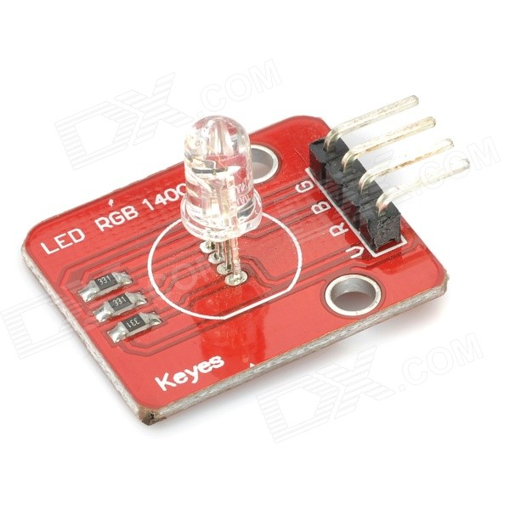
Sensors
Magnetic sensor
RGB LED

Slide 11
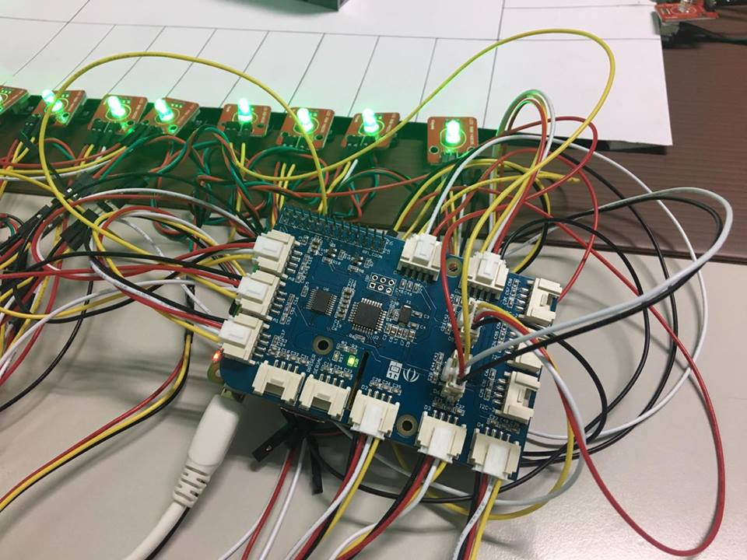
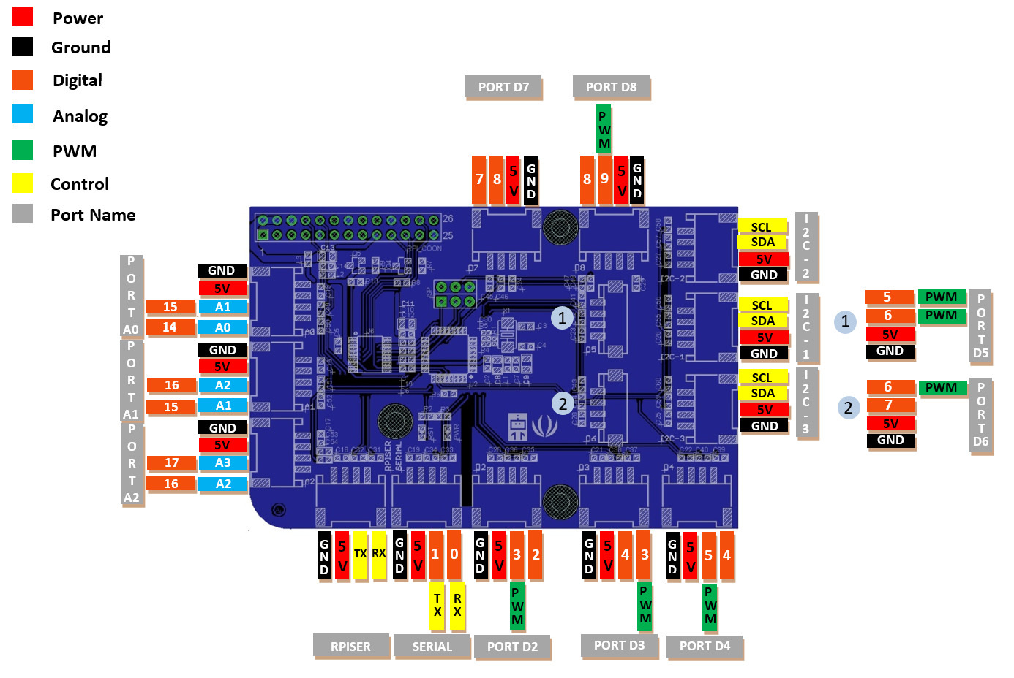

Slide 12
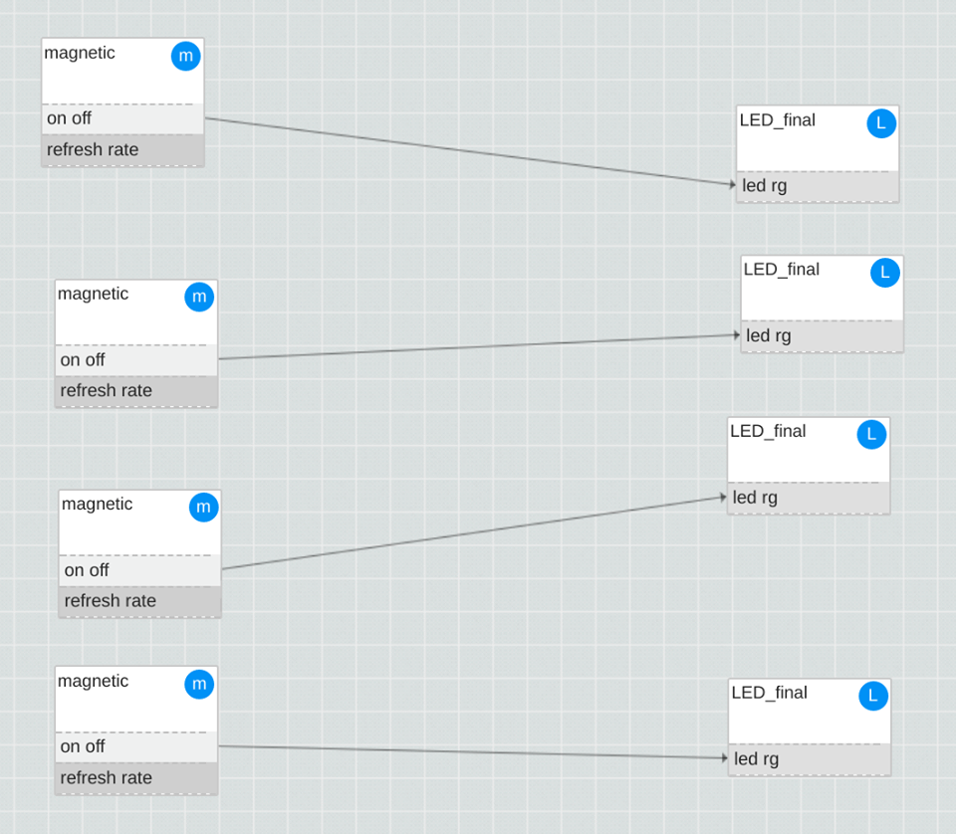
FBP

Slide 13
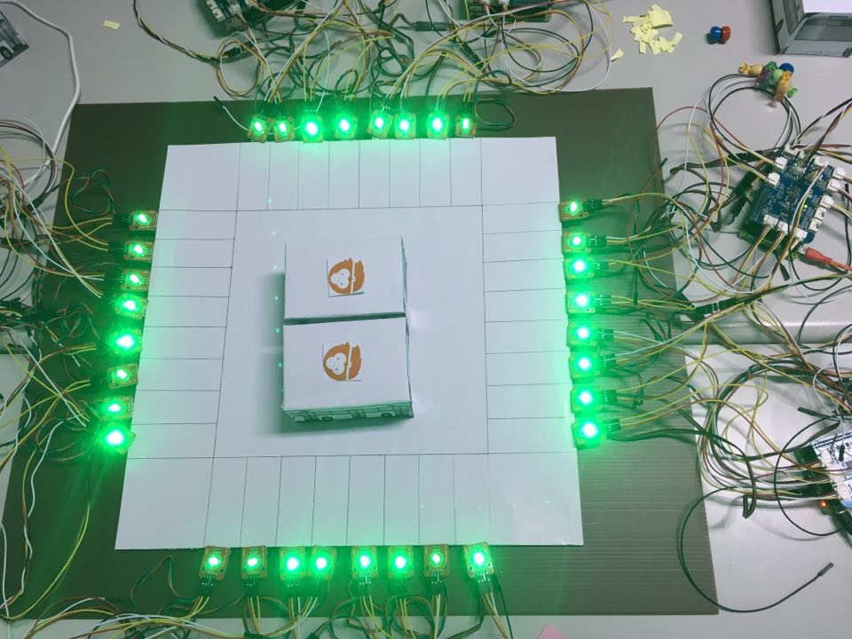
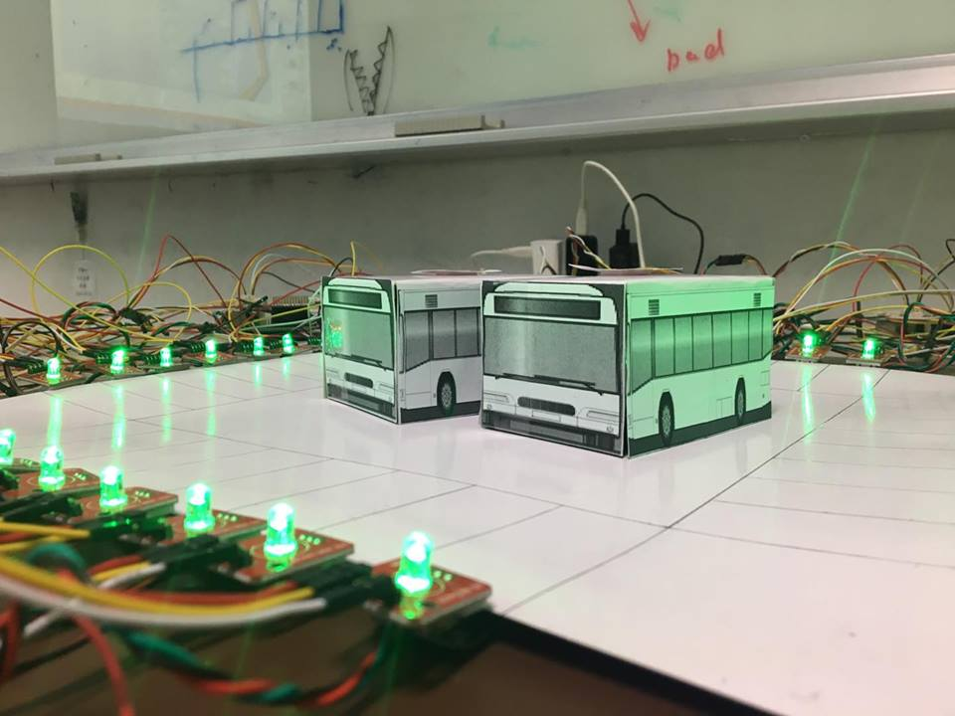
environment

Slide 14
Advantage
Utility of space
Improve user experience
Scalability

Slide 15
DEMO

Slide 16
IoT Final Project Dynamic Parking Space System
資工碩一 顏逸東
資工碩一 謝崴宇
電機碩二 吳明憲
電機碩一 林益璟
Q&A

